Slide 1
Hands On Lab
Prometheus & Grafana

Slide 2
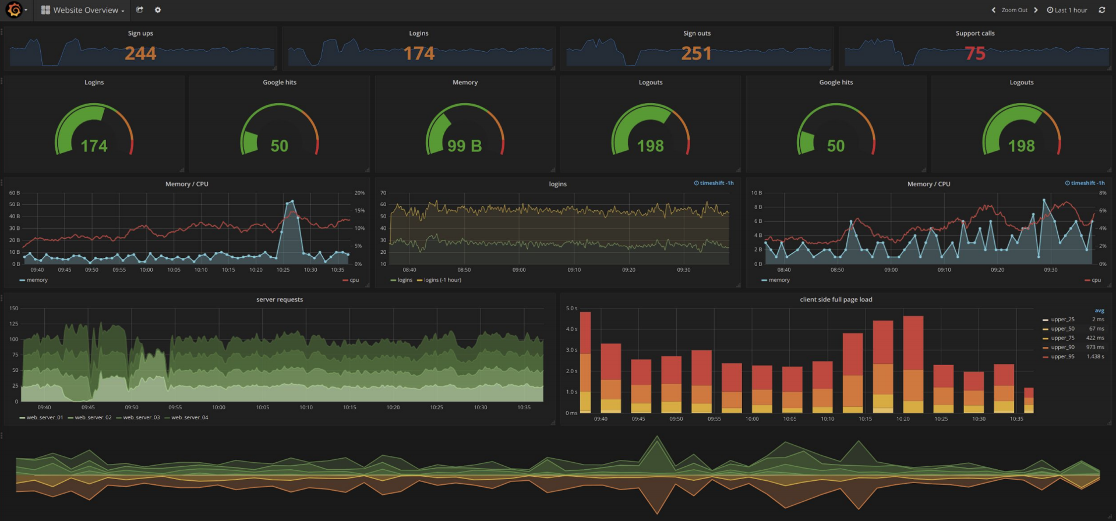

Slide 3
Grafana data sources
+60 Published Data Sources

Slide 4

Prometheus
Prometheus is an open source time series database that focuses on capturing measurements and exposing them via an API originally built at SoundCloud in 2012.
It’s simple and efficient.
Prometheus pull (“scrapes”) metrics from instrumented applications and store it on time series database as key/value pairs .

Slide 5
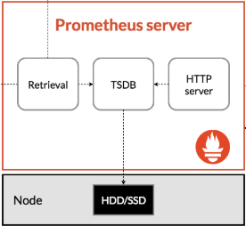
Prometheus Architecture
App
Http GET /metrics

Slide 6
Prometheus Architecture

Slide 7
Prometheus Metrics
# TYPE node_memory_MemFree_bytes gauge # HELP node_memory_MemFree_bytes Available Memory.
node_memory_MemFree_bytes 2.4608768e+08

Slide 8
Prometheus Metrics Labels
nginx_http_requests_total{status="200"} 1000 nginx_http_requests_total{status="400"} 1 nginx_http_requests_total{status="404"} 10

Slide 9
Prometheus Exporters
Apache
Nginx
HaProxy
Traefik
Docker daemon
cAdvisor
Kubernetes
Node-Exporter
MySQL
PostgreSQL
Redis
Elasticsearch
RabbitMQ
PHP-FPM
NodeJS
Python
Java
Go
Rust
Ruby
...
Full list : https://prometheus.io/docs/instrumenting/exporters

Slide 10
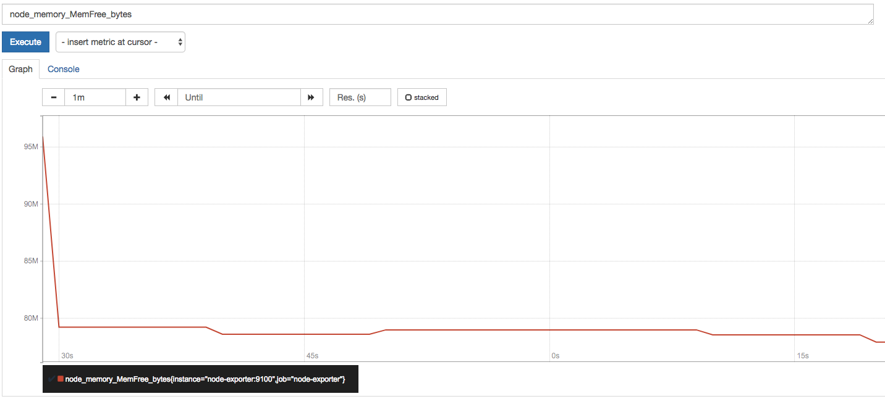
Prometheus query language : PromQL
node_memory_MemFree_bytes
nginx_http_requests_total{status="404"}
sum(nginx_http_requests_total{})
rate(nginx_http_requests_total{status="404"}[5m])
http_requests_total{job=~".*server"}
sum(rate(http_requests_total[5m])) by (job)
(instance_memory_limit_bytes - instance_memory_usage_bytes) / 1024 / 1024

Slide 11
It is time to practice
https://github.com/DemisR/workshop-prometheus-grafana

